Slide 1
Architecture and Design document
Submitted by TEAM BUG_INSPECTORS

Slide 2
Overview

Slide 3
Data extraction using comparison operators by iterating over the complete MT103 message.
Input message content is semantically verified against a simulated core banking service for credit availability.
The received file is tested for the predefined XML tags and format to ensure that data is in SWIFT-MX message type
Extraction of MT tags
Validation of INPUT
Core Banking system
MT->MX
Conversion
Validation of OUTPUT
Verifying the received input file against MT 103 Network Validated Rules for SWIFT-MX message type.
The XML file is created using string concatenation method. Along with the standard PACS.008 tags .

Slide 4
Main Module

Slide 5
Main Module
Module 1
MT Validation
MT->MX Conversion
Bulk inputs
Testing the program for over 400 input files in a single sec.
Module 2
MX Validation
Comparison of received output SWIFT-MX message file with standard XML tags for PACS.008
Module 3
Core Banking System
Semantic verification of the input message against predefined test user.
For credit availability and various other important fields.

Slide 6
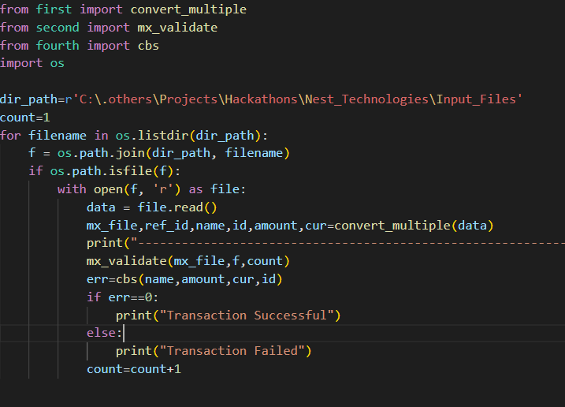
Main Module
This module acts as the connecting link between all individual modules.
The module also takes Bulk inputs and passes them to different modules for processing and storing them in orderly manner.
This module gives us the final output based on results received from all other modules.
The status of the transaction : FAIL/SUCCESS is reported here in the end.

Slide 7
Module 1

Slide 8
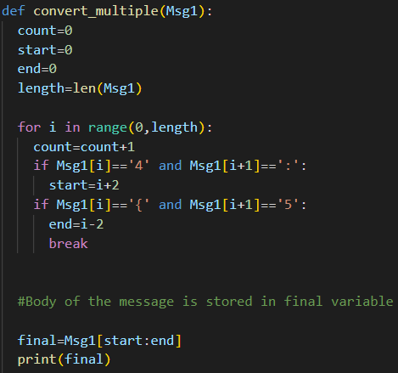
Module 1
As the original code for this particular module contains about 300 lines and explaining all of them will be a difficult task, we are going to elaborate on key components of the module!
The code is well commented and explanatory for your reference.
This module is a function which requests an MT103 file as an input parameter and returns the converted XML file as output.

Slide 9
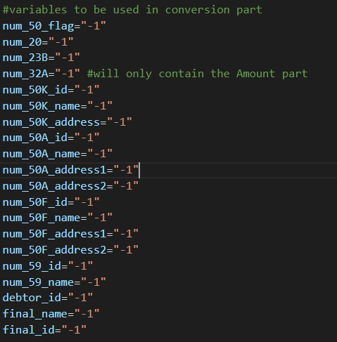
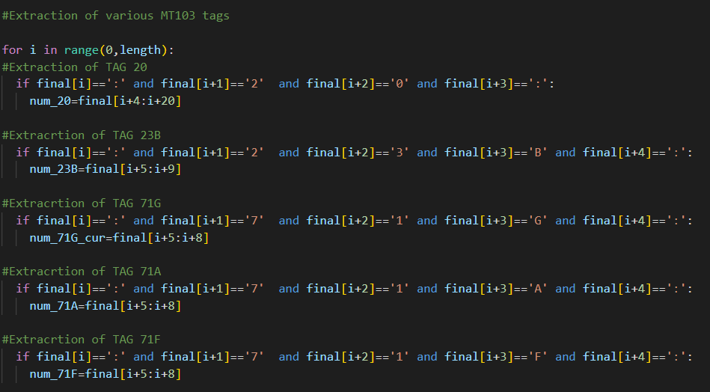
Module 1
Numerous variables are declared in order to store important MT103 tags extracted from the file.
The extraction of required field tags is carried out by string slicing and iteration.
These tags are later used in the program for the development of final XML file.

Slide 10
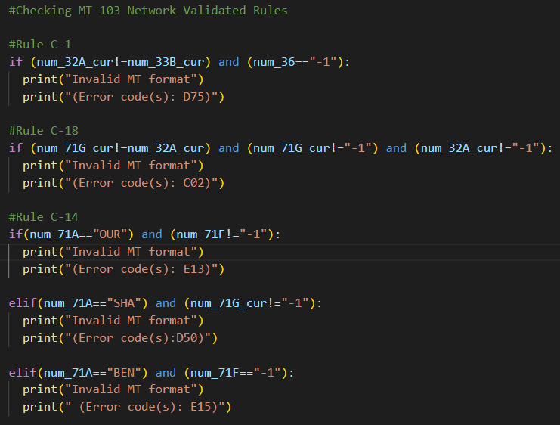
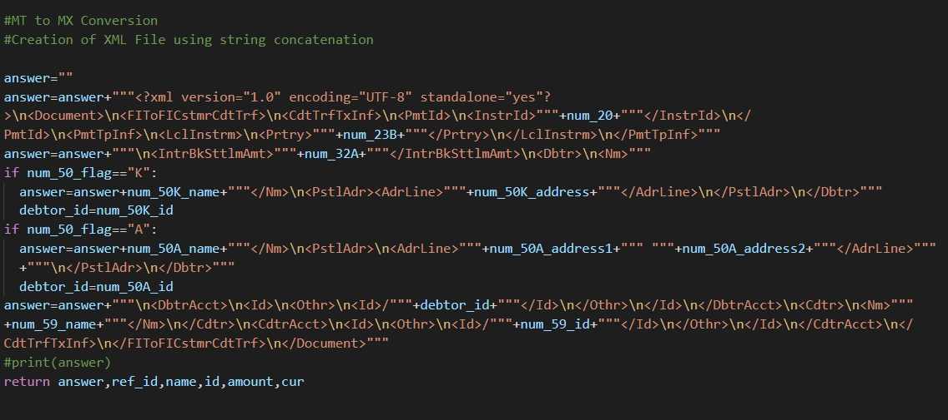
Module 1
Validation of the extracted tags is done by checking the file for MT 103 Network Validated Rules: C1,C14 and C18.
The XML file is developed using the tag values stored in variables that we defined in the first part of the code.
Finally, the output file along with some others parameters which would be required for verification under CBS are returned.

Slide 11
Module 2

Slide 12
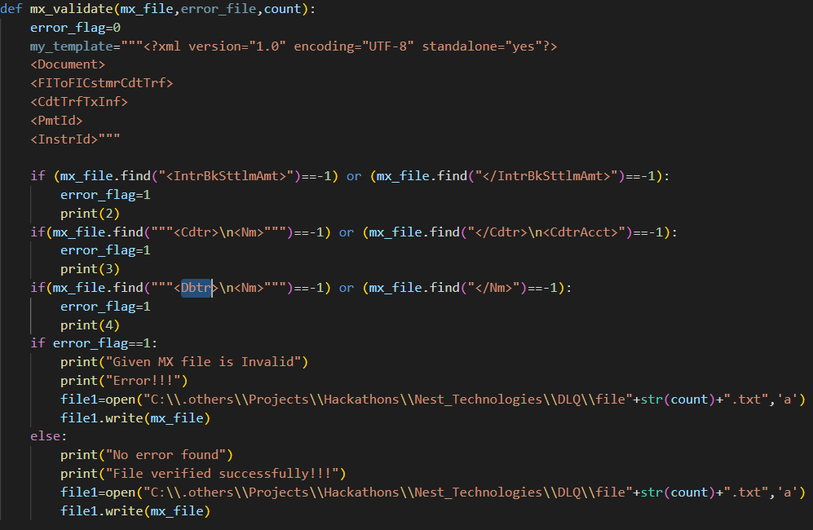
Module 2
The second uses the converted MX file and the count variable(defined in main module)as input.
The XML file is then tested for field tags like IntrBkSttlmAmt, Dbtr, Cdtr. The syntax of the opening and closing of tags is also verified.
If the message file fails to validate it is pushed into a Dead Letter Queue.
If the message passes the validation test it is stored into an output file.

Slide 13
Module 3

Slide 14
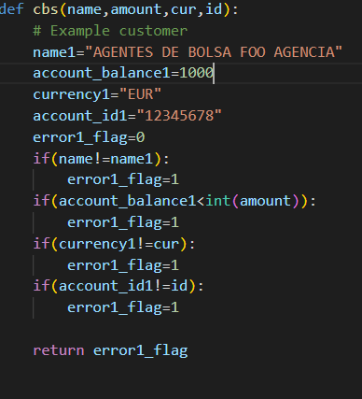
Module 3
This module acts as a semantically simulated Core Banking System.
The variables required in the function are- name, debtor id, transaction id, amount to be transferred and currency.
The given inputs are compared with the already stored values for credit availability and various other parameters.

Slide 15
Deployment

Slide 16
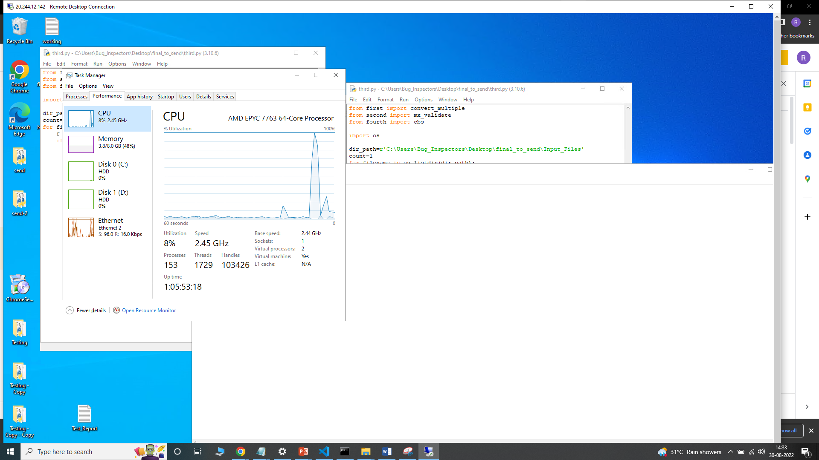
Deployment of solution
The deployment of our solution was done on Microsoft Azure cloud VM.
The specifications of the VM were:
CPU-AMD EPYC 7763 64 Core Processor
Memory - 8GB
OS - Windows 10 Preview

Slide 17
OWASP
(Penetration Testing)

Slide 18
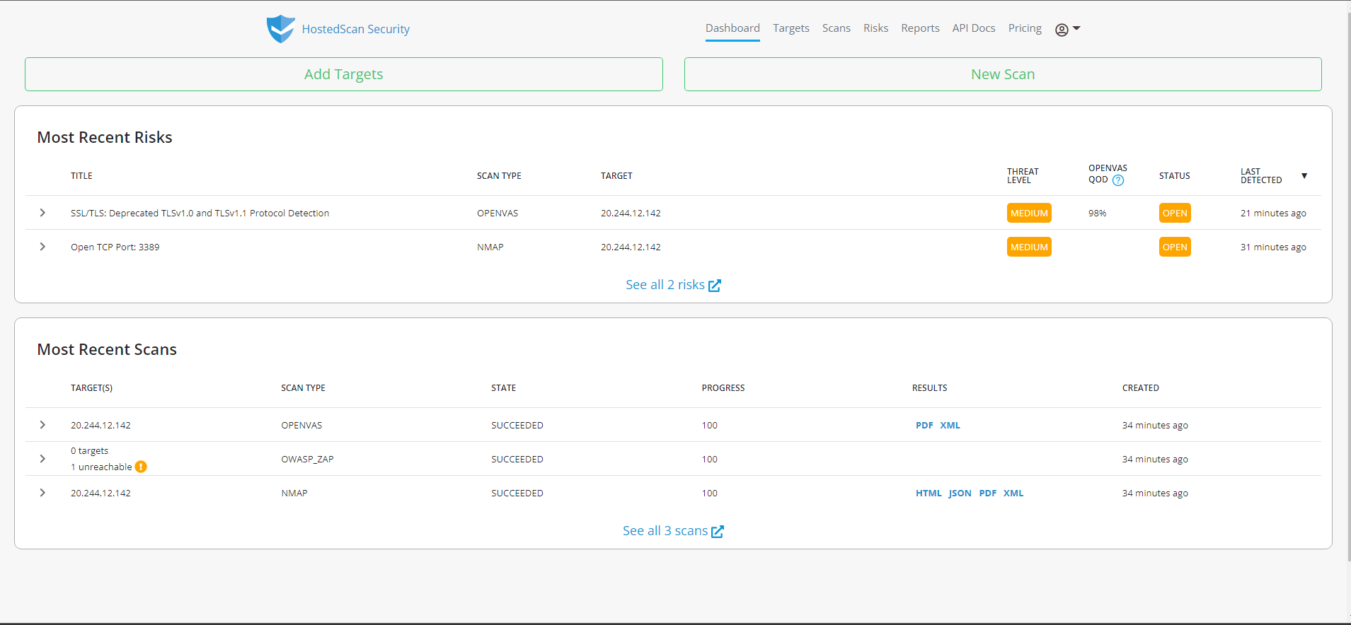
OWASP(Penetration Testing)
We used an online vulnerability scanner called HostedScan Security to test for shortcomings of the Host VM.
Three types of scans were conducted-
OPENVAS
OWASP_ZAP
NMAP
All of these scans were successfully completed and no High level threat or vulnerability was found.

Slide 19
How to run our code

Slide 20
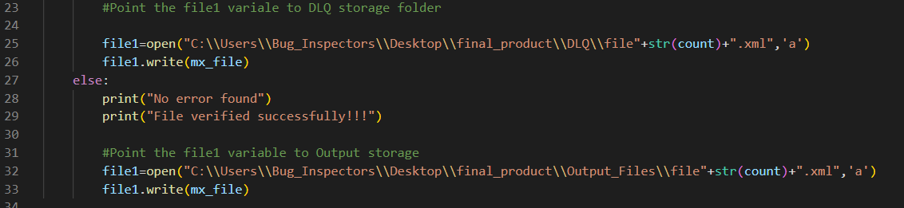
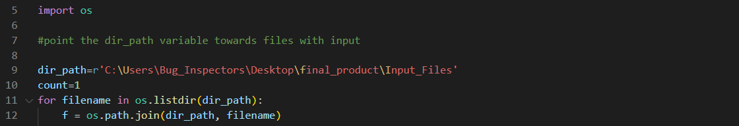
How to run our code
Inside the final_product folder firstly open the main.py file and edit the ‘dir_path’ variable and set it to the director where input files are stored.
Now, open the second.py file and point the ‘file1’ variable to Output and DLQ folders respectively.
That’s it ! Now run the main.py file and final file would be stored in DLQ or Output folder according to it’s validation.

Slide 21
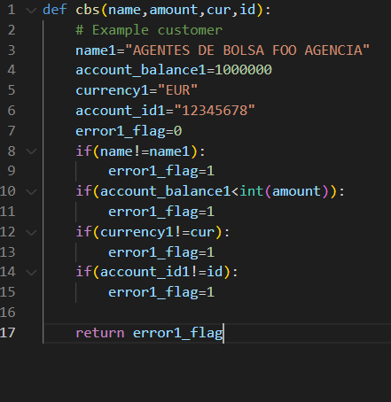
How to run our code
If you want to edit the details of the predefined user, you can do so by changing the details in third.py file.
Incase you receive an error saying “CBS failed” it means that the transaction cannot take place due to incorrect request values.

Slide 22
Microservices Pattern

Slide 23

Microservices Pattern
The entire program is divided into small components which can be deployed onto individual cloud VMs.
These VM’s can then be connected to each other via API services.
Due to shortage of time we were unable to connect these modules via API but our separate modules mirror a microservice system in its own sense.

Slide 24

MT101 -> PACS008

Slide 25
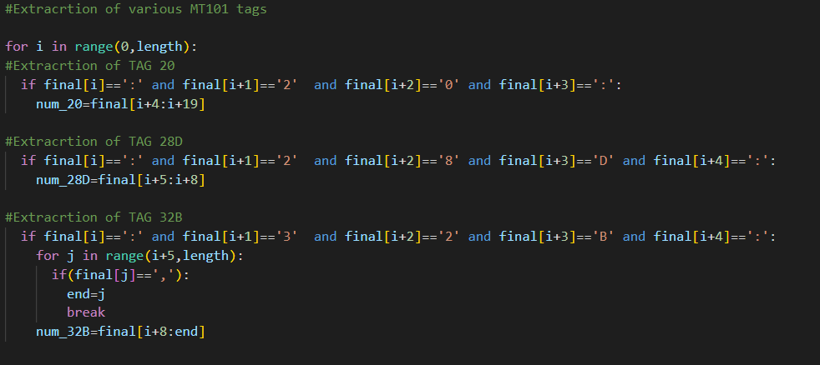
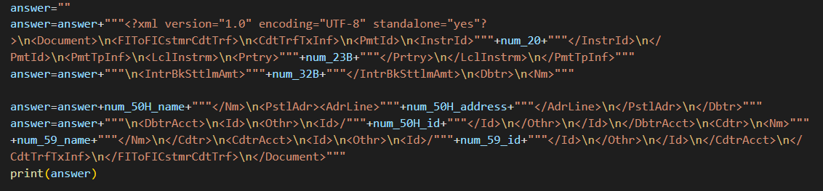
MT101 -> PACS.008
One of the sidequests of this hackathon was to implement an additional message type, so we went with MT101.
The process of conversion is similar to MT103 message type.
The tags are firstly extracted from the input file and stored in variables. The stored variables are then used for the creation of XML file.

Slide 26
Thank You
Bug_Inspectors signing off!

